Slide 1
MUSE - User-Sensitive Entrainment
Activity-Sensitive Musical Entrainment for Stimulatory Cognitive Control
Github link (project InWork)

Slide 2
Related Work
SigLIP Paper: Zero-Shot Learning w/Sigmoid Loss
MusicGen: Simple & Controllable Music Generation
Background Research
Sensory Processing in Autism Spectrum Disorders (Pediatric Research Foundation)
Prof. DiCarlo’s work on human visual-perceptive control
State of Generative Music & Audio-Generative Architectures
MIT Media Lab’s Semantic Synth Programming
NVIDIA Triton Temporal Fusion Transformer Architecture (OS)
Mesgarani N.A.P. Lab work on BCI-Augmented Attentional Control

Slide 3
Important Metrics

Slide 4
General Architecture
Static Data
(pers. Info)
Decoder
(context-aware generative)
(nearest-neighbor
+ glue)
Encoder
Decoder
(context-aware generative)
(nearest-neighbor
+ glue)
Decoder
(context-aware generative)
(nearest-neighbor
+ glue)
Activity Data
(HR, Accel)
(Audio)
Temperature Control
Activity Semantics
+
Activity Context
(Semantic info, HR, FFT?)
User Prompt Info
(Maybe Audio)
Audio Stream
Encoder Input Notes
maybe incorporate video, audio (model impl.)
Consider surprise-style query trigger
Decoder Input Notes
Heartrate Info or FFT?
prediction length impl
glue method with segment retrieval
Can pregenerate segments or semantics

Slide 5
Processing Architecture
Activity Data
(HR, Accel, gyro, temp)
Processing Pipeline
Encoder
Activity Semantics
Static Data
Prompt Info (Pers. Info)
Stream Processor
(Select & Stitch Segments)
Deviation Prcss (new generation thread)
Decoder
(semantic music generator)

Slide 6
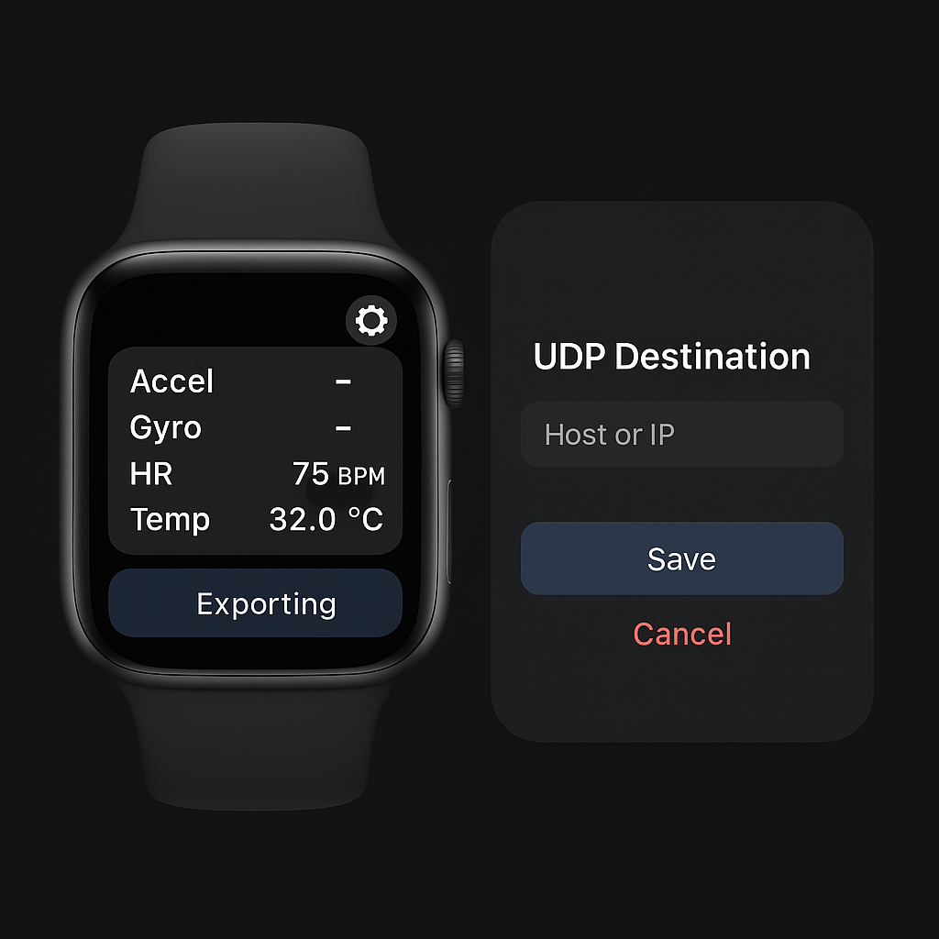
Activity Data Encoder
Data Acquisition (Apple Watch)
heartrate, accel, gyro (also altim, temp, magnet,.)
Vision-Language Encoder (ex)
Longterm; RLHF policy improvements and UI semantic prompt eng.
Gemma-type LLM to generate train-of-thought type semantics, or simply list-of-words input
(currently using Qwen-2B, possibly switch to CLIP)
Custom-Engineered Prompt:
Prompt significantly impacts quality, style deltas
long-term: consider context, audio, etc.

Slide 7
Encoder Structure
Vision Encoder – SigLIP / CLIP
Vision Language Model: SmolVLM(2025):
Output activity classes or token embeddings
256M(<1GB) – 500M(1.2GB) – 2.2B(4.9GB)
Fine-tuning script avail.
Other Options:
Moondream2 (smaller, less acc.)
Qwen2-VL-2B(2023) (larger)

Slide 8
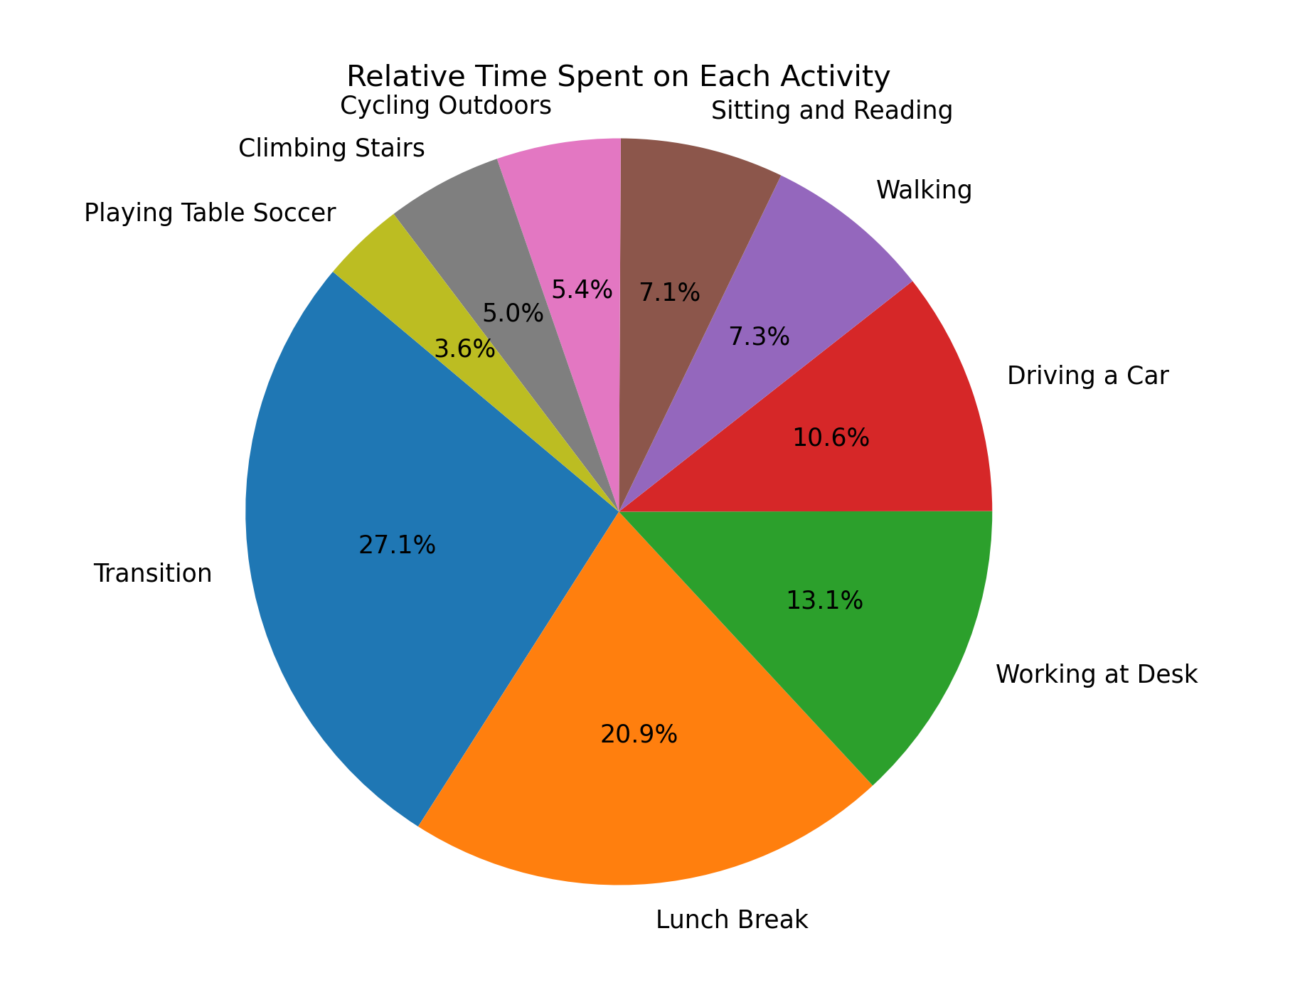
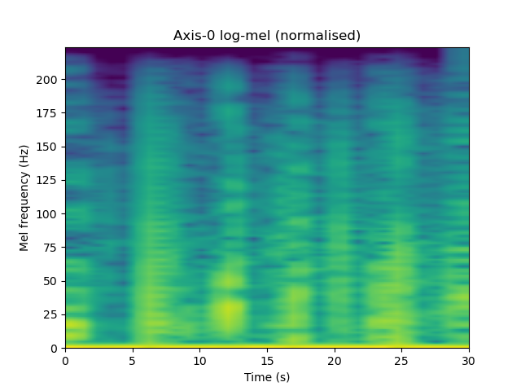
UC Irvine PPG Dataset (heartrate, 64Hz wrist accel, activity)
128k sec of activity data;
15 subjects, 9 activities (including transition)
https://archive.ics.uci.edu/dataset/495/ppg%2Bdalia?

Slide 9
“Latent Space” – Audio Model Input
Run activity info + existing prompt into audio input..
User interface controls:
Dials changing decoder input prompt, latent output temperature for customization

Slide 10
Audio Decoder
Audio model with latent / semantic context input
Context shifting, realtime indicators for latency management
Finetuned/pretrained generative music model – investigate input, latency
Cross-attentive / TFT-type architecture (multiple context sources)
Alternatives
K-nn style segmented dataset streaming or context provision
Provide knn context to generative model, or use chunks directly
Smaller “glue” model trained to transition between segments
Ex grab beat drop & stream in
Synthesizer-type audio control (see MIT lab)
Pretraining/RL with larger multimodal model for labelling & task convergence

Slide 11
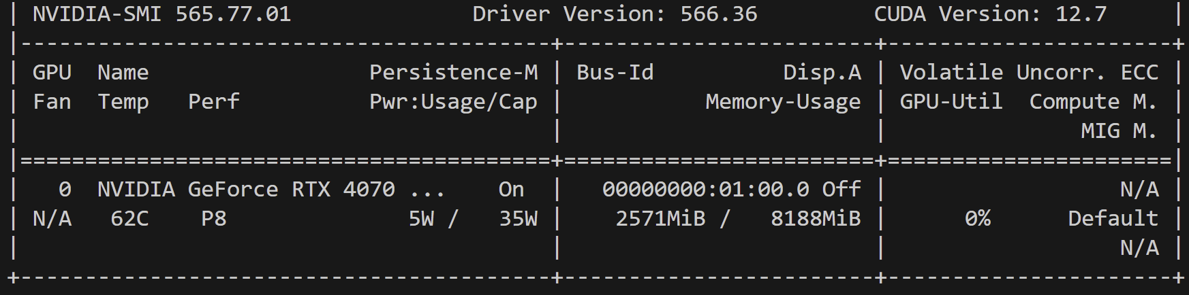
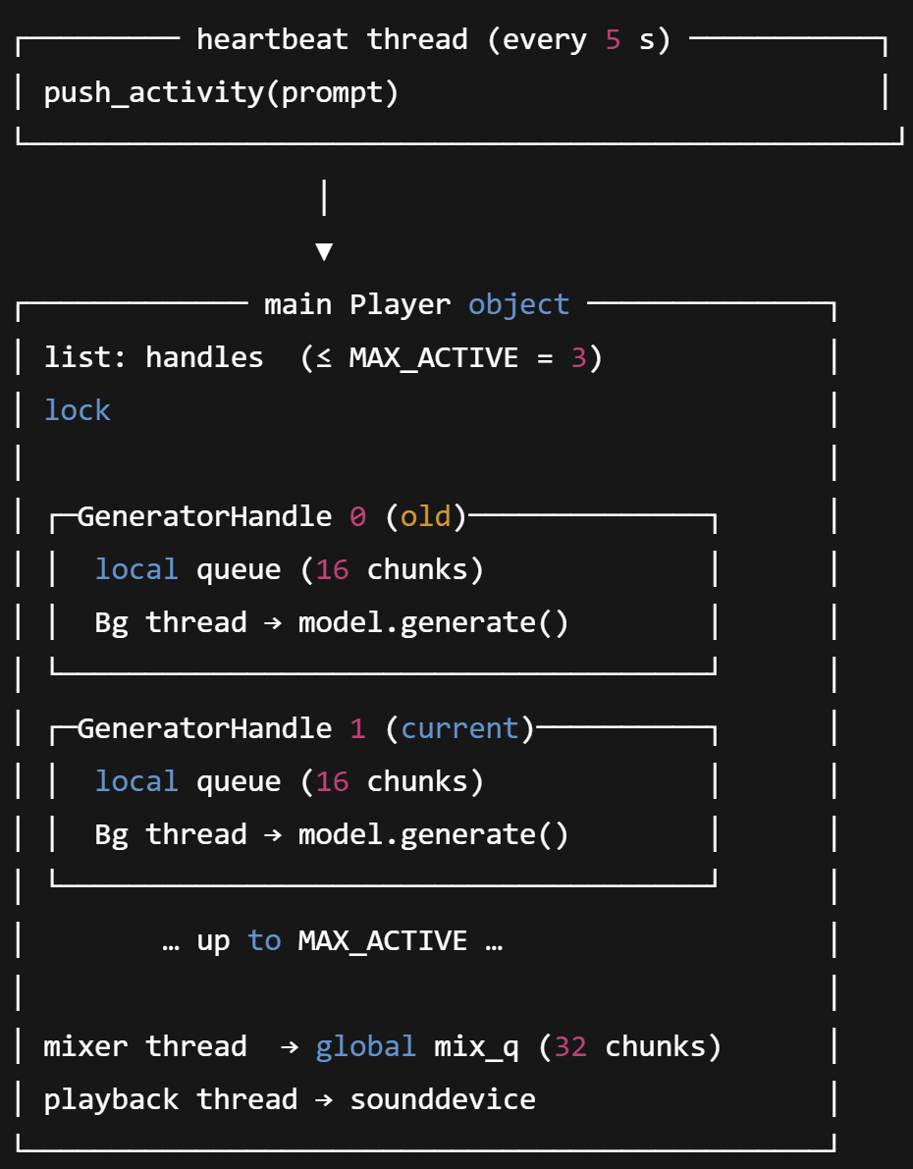
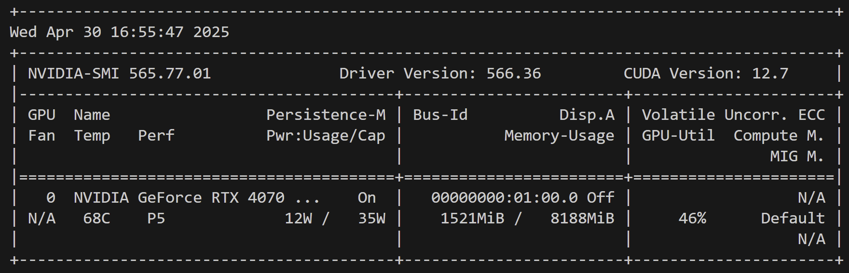
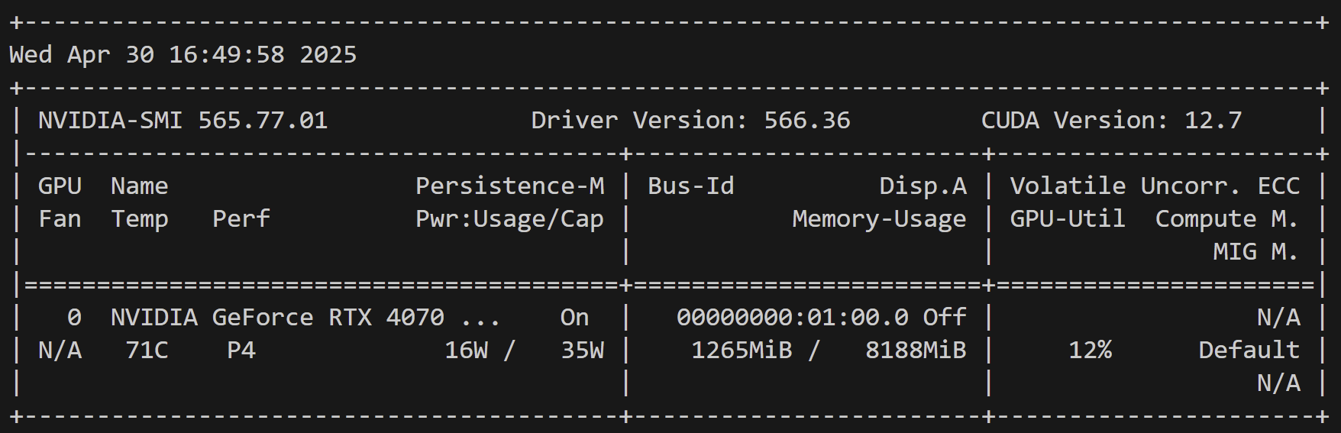
Streaming Decoder
FP16: 2.6GB
8-bit quantization: 1.6GB
With 4bit quantization: 1.2GB

Slide 12
Notes
Look into game music control
Inhibitory (ex ANC) vs Excitatory stimulus
Product Research & Development Stage – contact liam.mchugh@columbia.edu for more details

